Slide 1


Internship Report — Research & Reporting
Social Development Internship at Vishalakshi Foundation | Sakshi Priya, 25SCS1003003492 B.Tech (CSE) Sem 3, IILM University, Greater Noida
Duration: 04 June 2026 – 06 July 2026 • Submitted in partial fulfilment of the B.Tech internship requirement

Slide 2

Executive Summary
This report documents a four-week Social Development internship focused on research and reporting at Vishalakshi Foundation. Activities included information collection, source verification, structured drafting, and final report preparation. Key outcomes: organized research materials, improved professional writing and documentation practices, and a complete internship deliverable suitable for academic submission.

Slide 3
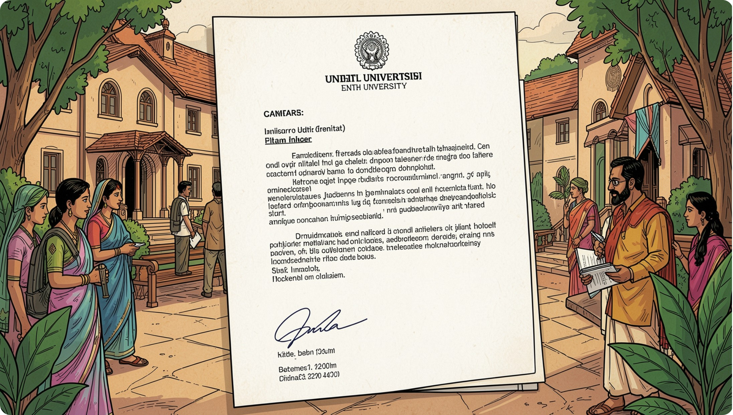
Candidate's Declaration & Acknowledgment
Declaration
I, Sakshi Priya, declare that this report is an original record of my internship (04 Jun – 06 Jul 2026) as a Social Development Intern. All external sources are acknowledged in the bibliography.
Acknowledgment
Grateful to Vishalakshi Foundation mentors and university faculty for guidance and feedback that shaped my research, documentation, and professional habits.

Slide 4
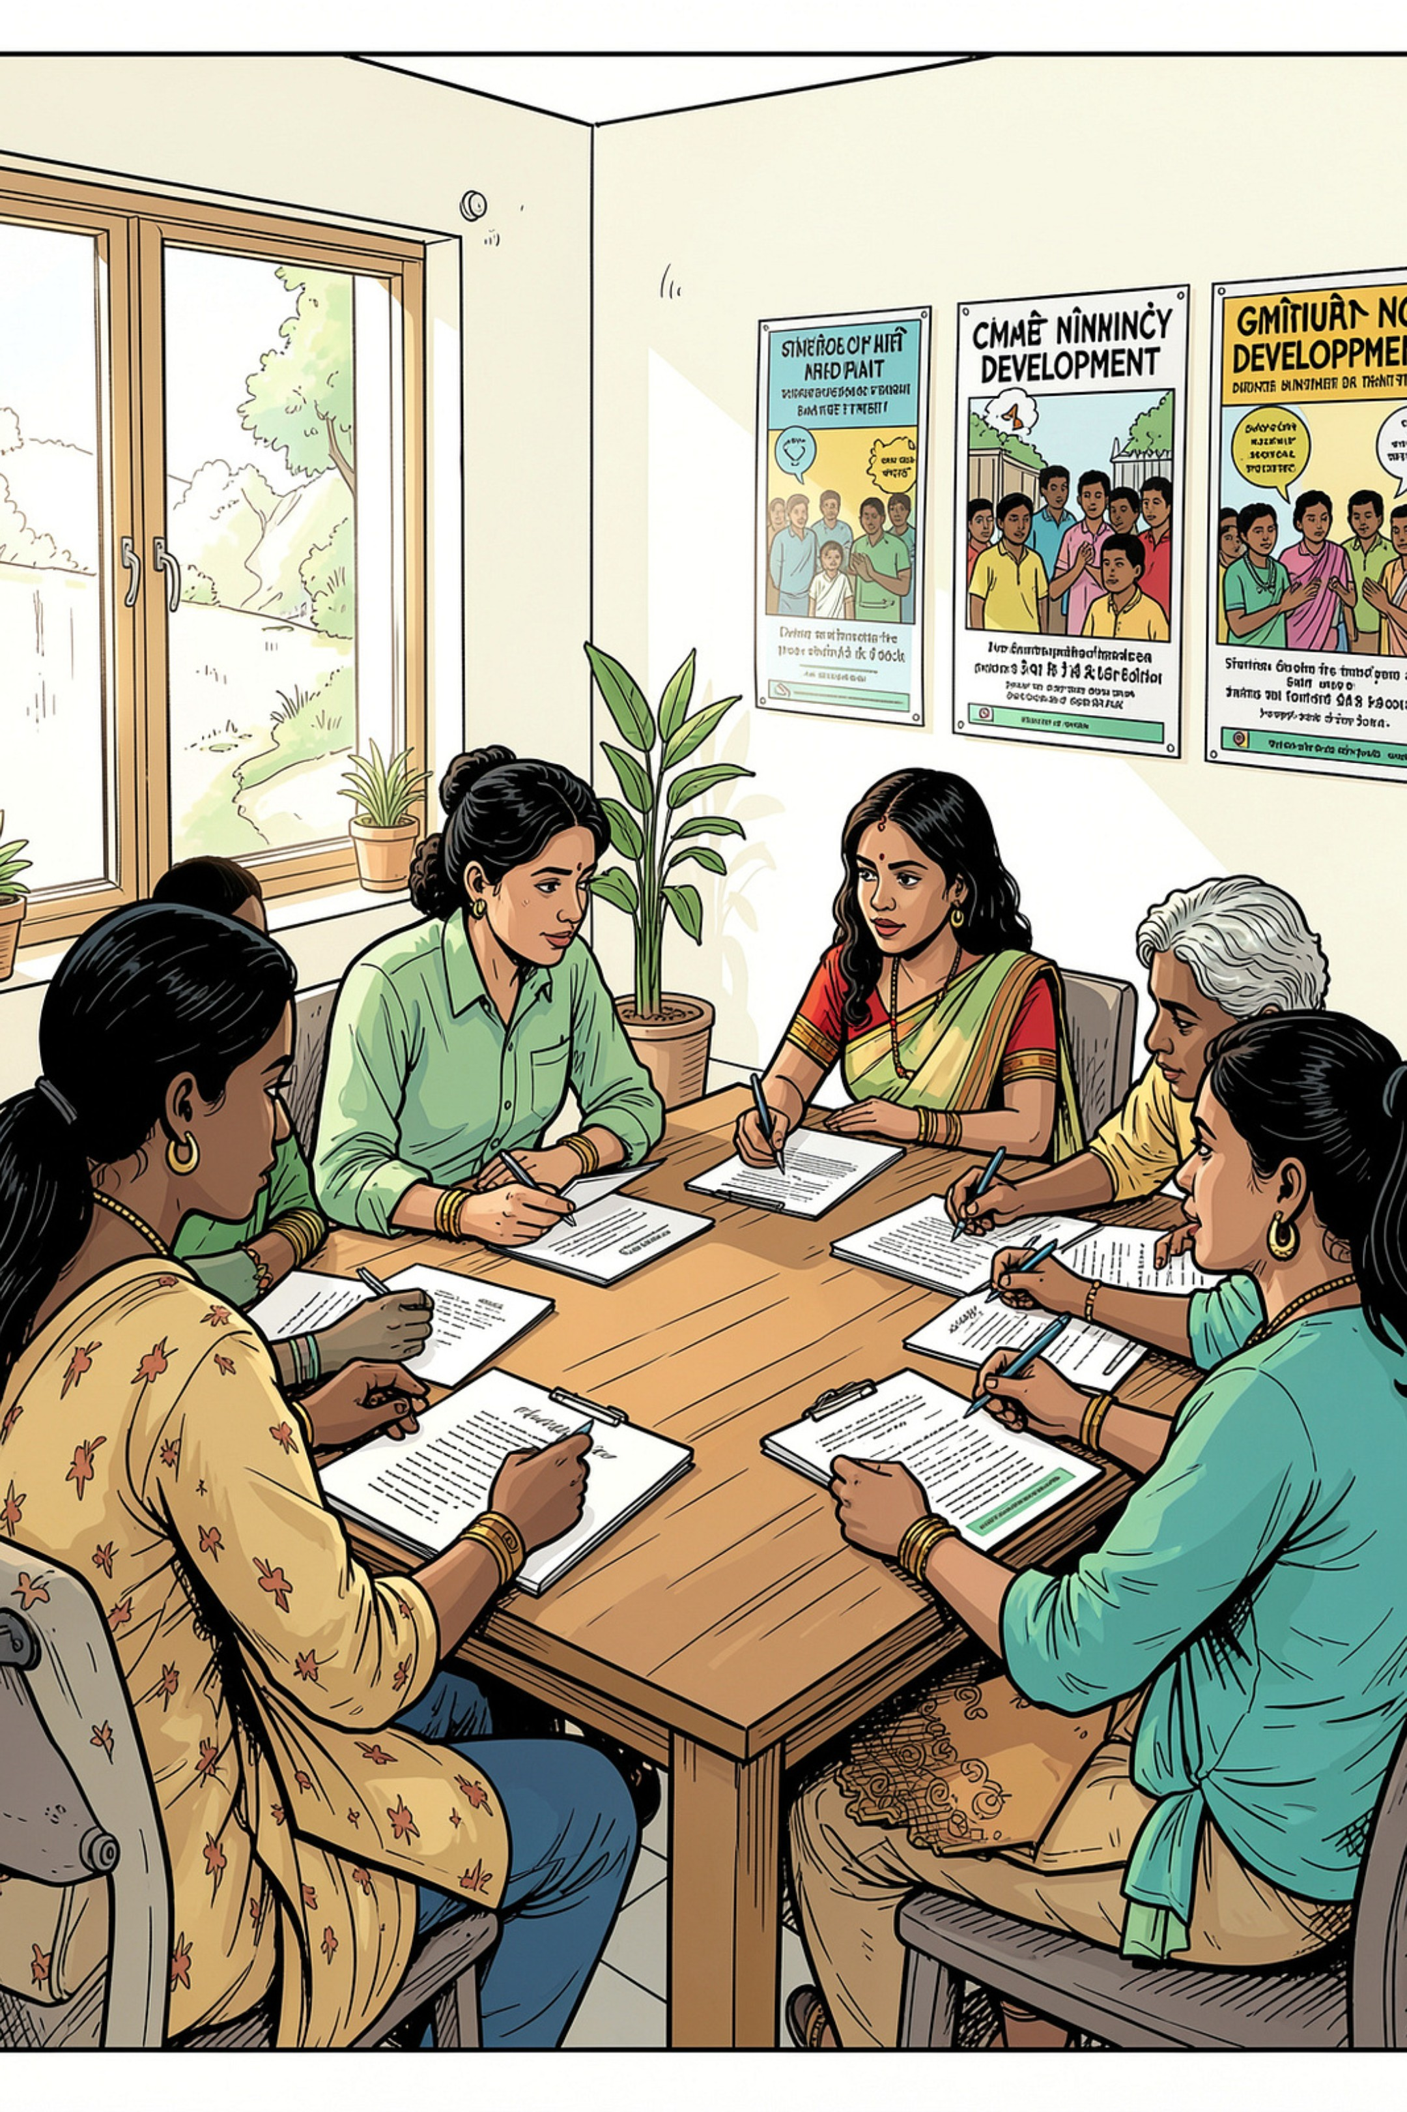
Organization Profile
Vishalakshi Foundation is a social-development organisation that relies on evidence-based research and clear reporting to plan and communicate programmes. The internship exposed the intern to organizational workflows, responsible handling of community information, and the role of documentation in program design and review.

Slide 5
Problem Statement & Project Objectives
Problem Statement
Project Objectives
Unstructured information from varied sources impedes retrieval, consistent communication, and organisational learning. The internship addressed the need for a systematic research-and-reporting workflow: selection, verification, consolidation, and clear presentation of social-development information.
Understand research and documentation needs of the organisation
Collect and screen primary and secondary sources
Organize material into clear sections for reporting
Draft concise, professionally formatted reports
Improve editing, proofreading, and presentation skills

Slide 6

Scope, Tools & Process Architecture
The project focused on documentation-oriented tasks: research support, information collection, organization, analysis, drafting, editing, and final reporting. Primary tools included web search, Google Docs / MS Word, Google Sheets / Excel, email, PDF utilities, and presentation tools.
Task Intake
Source Identification
Understand assignment, scope, and deadlines
Locate organizational documents and reliable external references
Screening & Verification
Drafting & Review
Structure, edit, and finalise report
Remove duplicates, check reliability

Slide 7

Methodology — Stepwise Approach
Understand
Plan
Collect
Verify
Organize
Each step emphasized relevance, accuracy, source-tracing, clarity, and ethical handling of sensitive information. Iterative review and feedback were integral to improving quality.

Slide 8



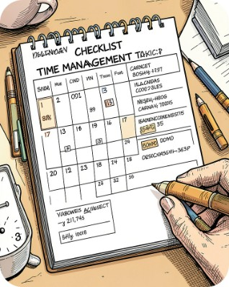
Work Performed & Skills Developed
Research Skills
Editing & Communication
Systematic search, relevance filtering, citation tracking.
Clarity, format consistency, proofreading and professional tone.
Professional Practice
Time management, receiving feedback, responsible documentation.

Slide 9

Expected Outcomes, Limitations & Ethics
Expected outcomes included structured research folders, concise professionally formatted reports, improved evidence-based summarization skills, and strengthened documentation habits. Limitations: short internship duration (04 Jun–06 Jul 2026) and scope confined to research/reporting — not an organisational impact evaluation. Ethical practice required consent-aware, non-identifying presentation of any community information and clear source attribution.

Slide 10

Conclusion, Bibliography & Next Steps
Conclusion
Selected References
The internship bridged academic methods and workplace reporting practice. It demonstrated that disciplined research workflows and careful reporting materially improve an organisation’s ability to capture and communicate learning.
Vishalakshi Foundation — Internship Completion Certificate (04 Jun – 06 Jul 2026)
Organisation’s internal instructions and materials provided during the internship
Microsoft Word and Google Docs documentation (formatting & templates)
Assorted secondary sources consulted (detailed references retained with research notes)
Next Steps
Integrate feedback from supervisors and submit finalised report
Attach certificate and any required communication proof as annexures
Preserve organised research materials for future organisational use
Certificate and communication-mail proof are appended to the formal submission where required by university guidelines.

